Slide 1

Machine Learning Meets Phylodynamics
A modern approach for historical host shifts
@vibelab.co.uk

Slide 2
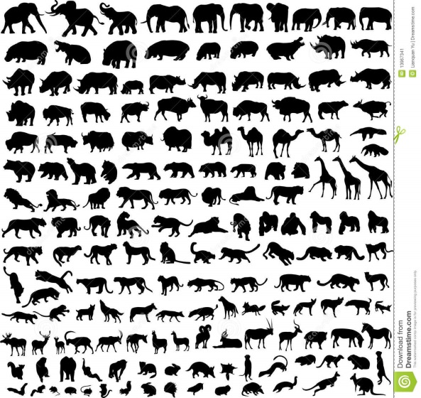

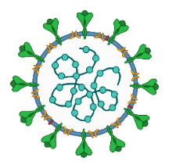
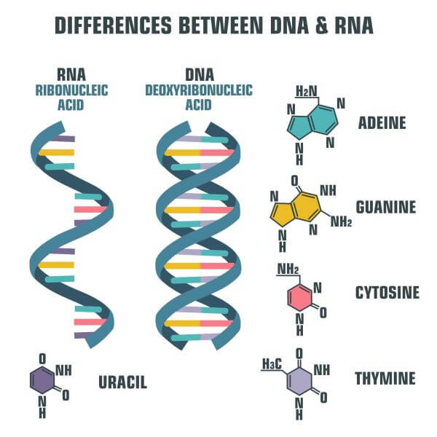
epidemiology
contact tracing
ecology
lab study
?
Notes:
We’re interested in zoonotic emergence and cross-species transmission
Understanding animal origins of virus – refer as “Host prediction” is traditionally a very lengthy, and often inconclusive exercise
Traditionally take years of ecological analysis, contact tracing, even laboratory study
However now the first data we are likely to have about any new virus is its genome sequence, and sometimes that’s the only data available, but we can use that to help infer the animal origin through machine learning

Slide 3
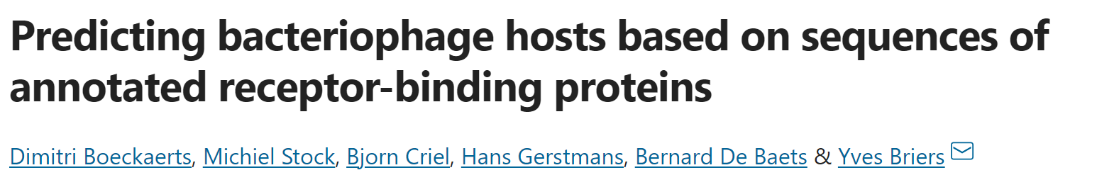

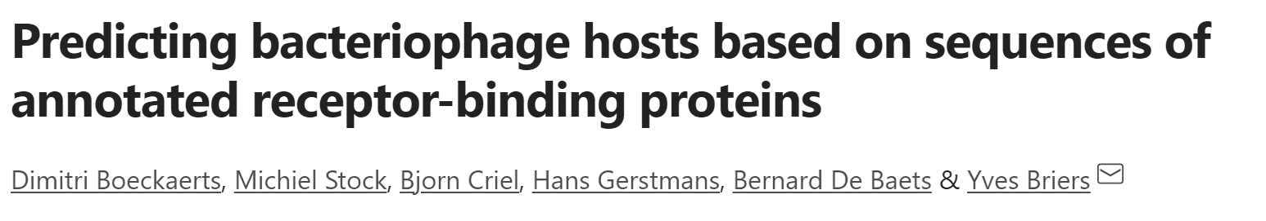


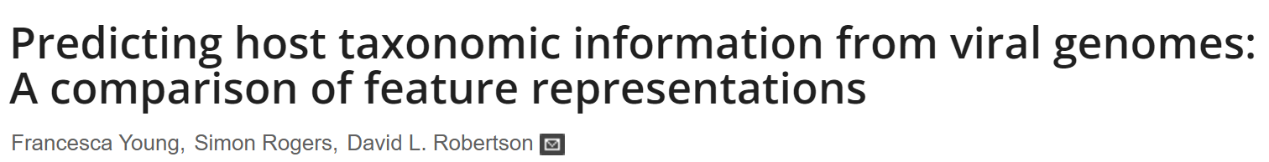
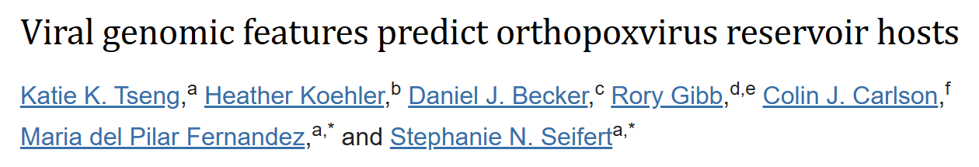
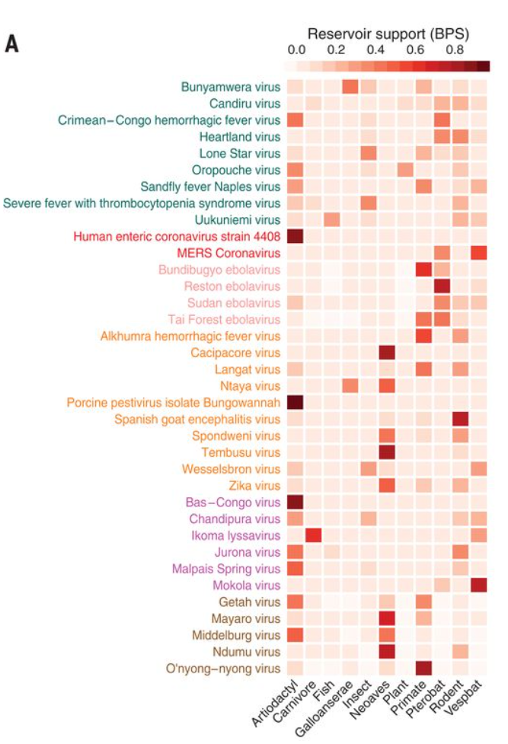
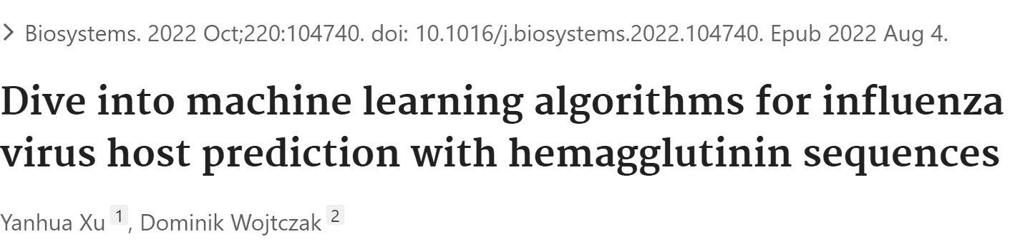
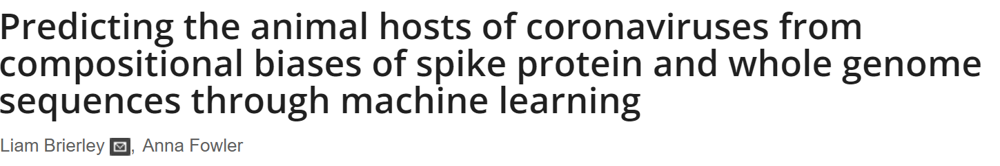
“Genotype-to-phenotype” host predictors:
computationally accessible
alignment-free
Babayan et al. Science. 2018; 362: 577–80.
Notes:
Now since methods are much more computationally accessible than before, and you can do them without strictly needing to do more traditional alignment of sequences, training these “genotype to phenotype” machine learning models on features of genome sequences is now a staple part of toolkit to understand what host a virus originates from
One prominent example is work by Simon Babayan, Richard Orton and Daniel Streicker here in Glasgow to classify viruses coming from a very diverse range of host types including mammals, fish, insects, plants, so on
But there are many other studies and groups doing so from phage to poxviruses to flu
- CoV own work

Slide 4
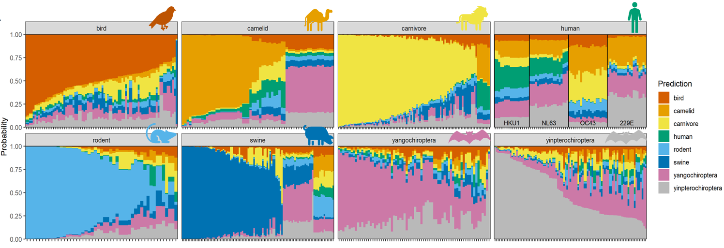
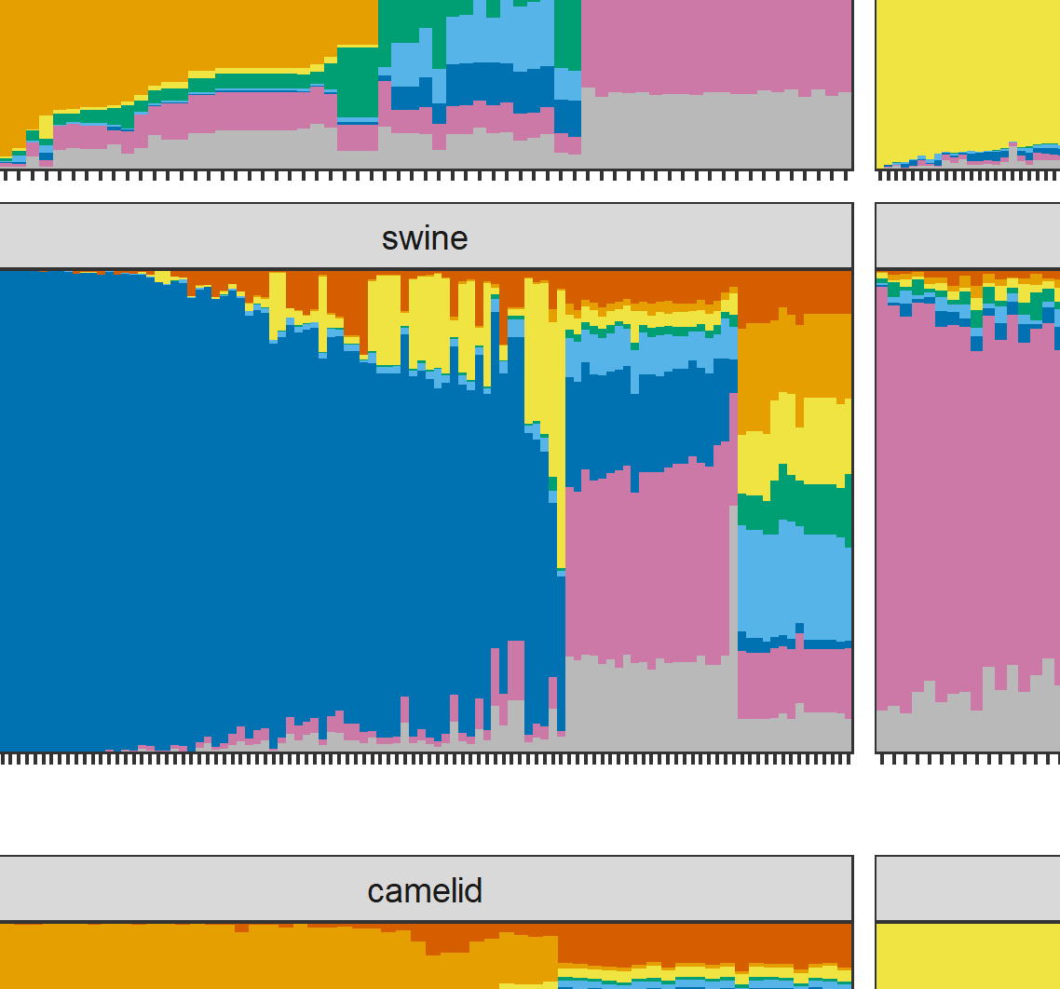
Random forest based on genome composition features:
convergent evolution?
model noise?
signal of previous host?
Brierley & Fowler. PLOS Pathogens. 2021;17:e1009149.
Notes:
Each panel here represents the coronaviruses from a different host, then these are just stacked area plots where each vertical strip is an individual sequence from that host, coloured according to model predictions, ordered by probability correct Bird viruses seem easily distinguished from mammals, in the top left the red bird section in each strip is bigger than other predicted hosts, except one sequence on the right border predicted as a swine virus
Essentially a bigger area the same colour as the animal icon the better the model performance, so we can see models generally perform well predicting bird, rodent, carnivore viruses, but often struggle to distinguish viruses from humans or livestock
Focus on swine
Where we get predictions that are incorrect few competing explanations
Convergent unlikely as nothing to suggest bat-pig similar no pig predictions in bat
Model noise – some sequences generalised confusion [["Porcine hemagglutinating encephalomyelitis virus“]]
Suspect signals of previous host but imprecise and hand-wavy [["Porcine epidemic diarrhea virus“, is AlphaCoV and turns out it is thought to be bat-origin spillover]] Not any consensus on how to tell these explanations apart or how we quantify if models are correct and our label is “wrong”

Slide 5
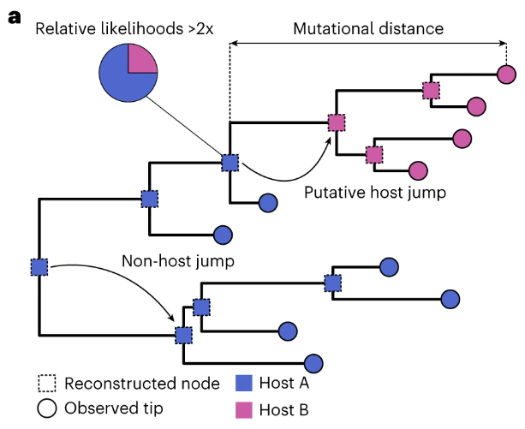
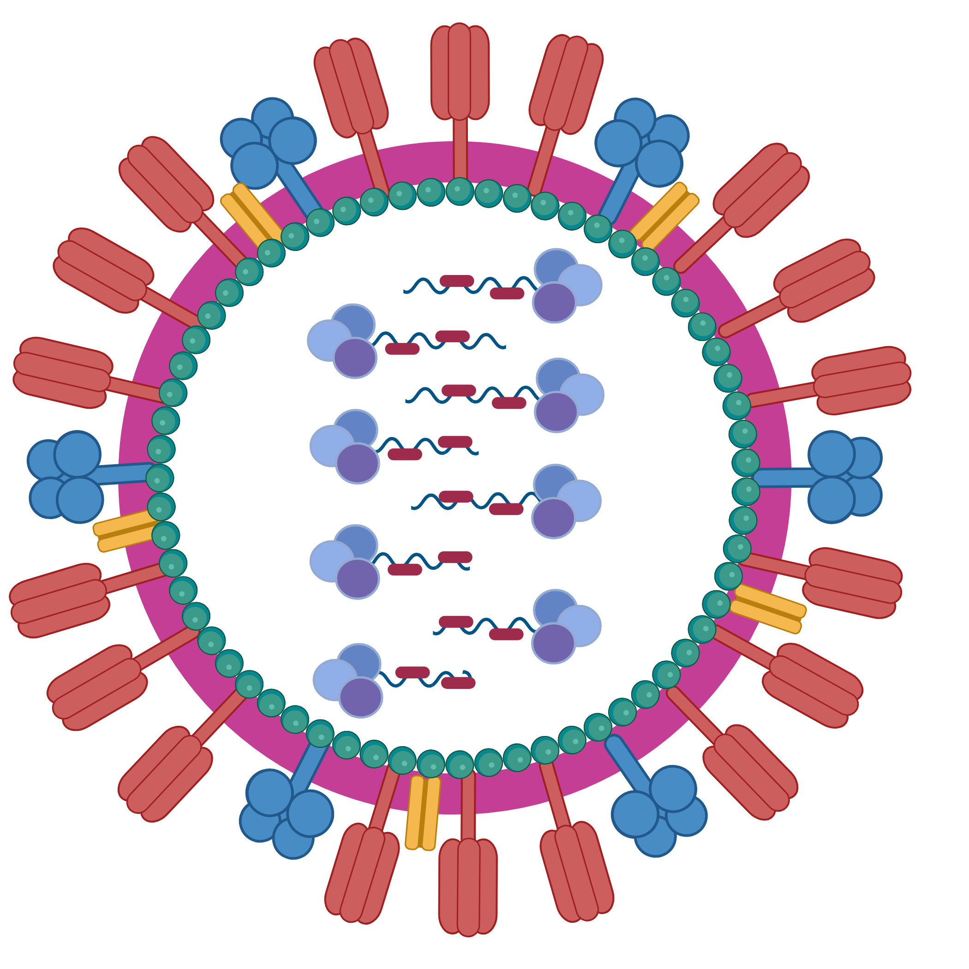
Ancestral state reconstruction:
Q. How do signals of ancestral host shifts in machine learning predictions compare to phylogeny?
Influenza A virus:
global health priority (H5N1 etc)
good evidence for historical host shifts between bird/mammal groups
Figure: Tan et al. Nature Ecol Evol. 2024;8:960-971.
Notes:
The other way is through phylogeny considering host as a discrete trait and conducting ancestral trait reconstruction to estimate when that host shift took place Circles here are sequences of two theoretical hosts and squares are reconstructed ancestry, and can estimate relative likelihood of each host species being host of ancestral virus sequence
So here we aimed to investigate how signals of ancestral host shifts manifest in predictions from machine learning host predictors compared to phylogenetic reconstruction and whether most informative ML features also change over the phylogeny in the same way as ancestral host prediction
Focusing on influenza A virus as a recent use case of interest where we have decent evidence of when and where some historical cross-species jumps across large phylogenetic host gaps have happened
I want to point ML/phylo, they’re not 1:1 substitutable, they ask different questions that are useful in different situations….

Slide 6
Nucleotide or Protein sequences
Machine Learning
Physico-chemical properties of proteins
Phylogenetics
Inherently related to virus meta-data (host, subtype, etc.)
Agnostic of virus meta-data
Easy to add new observations
Analyses are fairly intuitive
Analyses can be rather abstract to interpret
Time-sensitive
Relates samples to each other
Can be experimentally-validated
Generalisable to other samples
Struggles with highly-divergent samples

Slide 7
Data Curation
Wanted IAV with distinct host groups, and with evidence of host jumps

Slide 8
Avian | Bat | Dog | Horse | Human | Pig
2452 | 3 | 25 | 18 | 722 | 1331
4551 samples
Notes:
So which data did we use? We pulled all instances of flu genomes from NCBI when the host of origin was known and there were sequences for all 8 IAV genomic segments. Next, as the focus is on historical host shifts, we wanted only to keep samples that have naturally circulated in hosts from at least a year – no spillovers or recent jumps. This is just because the type of protein features tend to evolve slowly and take some time to adapt to a new host. Then, to train the models, we identified the IAV subtypes that appeared most frequently – subtypes which had more than 25 samples. The exception to this was two bat-specific subtypes, which had only 5 samples between them, but we needed some bat sequences to be included so the model had something to train on & recognise.

Slide 9
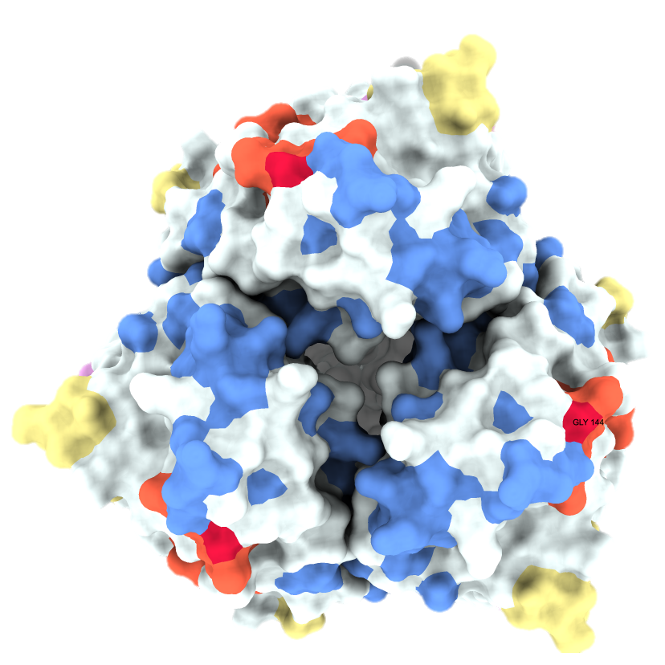
Machine Learning Models
Sequences are labelled according to the host of origin
Random Forest models are trained on protein compositional and physio-chemical features
Accession | Subtype | Label | DPC AA | DPC AD | DPC AE
AFM09352.1 | H5N2 | Avian | 0.00664 | 0.00398 | 0.00133
JN543647.1 | H9N2 | Avian | 0.00535 | 0.00402 | 0.00134
JN543651.1 | H9N2 | Avian | 0.00536 | 0.00402 | 0.00134
JN543662.1 | H9N2 | Avian | 0.00670 | 0.00402 | 0.00134
AIE48553.1 | H1N1 | Mammalian | 0.00528 | 0.00264 | 0.00264
AIE48735.1 | H1N1 | Mammalian | 0.00528 | 0.00264 | 0.00264
AIE49234.1 | H1N1 | Mammalian | 0.00661 | 0.00264 | 0.00264
AEK86179.1 | H1N2 | Mammalian | 0.00661 | 0.00132 | 0.00264
IAV
Gene
Protein
Protein Physio-chemical Properties
Notes:
So what kind of models are we talking about when referencing “protein features”? So far, we’ve stuck with a handful of features that describe the composition of protein sequences: how many times do certain amino acids show up within the protein, what sort of amino acids are present in the protein? Like the example illustrated here, where the amino acid alphabet is reduced to just 7 groups based on similar charges, weights, that kind of thing. Or alternatively, just raw metrics regarding the protein as a whole: its hydrophobicity, its solubility, charge etc.
These are what we used in creating the many, many random forest models that are the basis of this half of the project.

Slide 10
Model₁: Label ~ AA+AD+AE…
Accession | Subtype | Label | DPC AA | DPC AD | DPC AE
AFM09352.1 | H5N2 | Avian | 0.00664 | 0.00398 | 0.00133
JN543647.1 | H9N2 | Avian | 0.00535 | 0.00402 | 0.00134
JN543651.1 | H9N2 | Avian | 0.00536 | 0.00402 | 0.00134
JN543662.1 | H9N2 | Avian | 0.00670 | 0.00402 | 0.00134
AIE48553.1 | H1N1 | Mammalian | 0.00528 | 0.00264 | 0.00264
AIE48735.1 | H1N1 | Mammalian | 0.00528 | 0.00264 | 0.00264
AIE49234.1 | H1N1 | Mammalian | 0.00661 | 0.00264 | 0.00264
AEK86179.1 | H1N2 | Mammalian | 0.00661 | 0.00132 | 0.00264
using the features from non-H1N1 proteins only
Notes:
We therefore start with ~35,000 sequences, but many of these were similar enough to provide little novel information to the model so our first step was to cut down on the number of sequences we’d use. A clustering algorithm (within the MMSeq2 program) ran over these samples and retained only those which had 95% or lower sequence identity in order to capture the widest range of diverse proteins. This narrowed us down to just under 6700 proteins in total; some of which were from the same virus so we ended up with 4551 unique virus genomes.
Then compositional and chemical features of proteins calculated with iFeaturesOmega were used to train random forest models. As I mentioned, an important part of creating these RF models is holding out a subset of the data to be used as part of the validation process; therefore each of the 25 flu subtypes we identified was removed iteratively from the training data.
The first model used the 2mers as the predictive feature for the HA protein, using all of the dataset except for the proteins coming from H1N1 viruses. So the first model sees all of the non-H1N1 HA proteins and “learns” to classify sequences as avian or mammalian based on their protein features. Then, the H1N1 data that we hid from the model is presented as entirely novel and used to make a prediction; the model has never seen any of these H1N1 sequences before so can it attribute the correct label to them?

Slide 11
Feed H1N1 test data into Stack₁ model to assess model competency
Repeat for each of the 25 selected subtypes
Notes:
So all of that is just the first model! We then expand this to each of the protein features and each of the 8 major IAV proteins. Resulting in 48 different models which are then stacked – compiled in a way such that any features of any protein could be fed into the model and we get an output prediction of whether that protein is from an avian or mammalian virus. Then, we go back to the beginning of the modelling process to do the same with H1N2: proteins of H1N2 viruses are “held-out” and we make another 48 models of each feature set and each protein which are combined into Stack 2. Stack 2 is then validated using the H1N2 data that we put back in and you get the picture… A collection of models that look at the input of some protein features and give an estimate of whether the protein comes from avian or mammalian viruses.

Slide 12
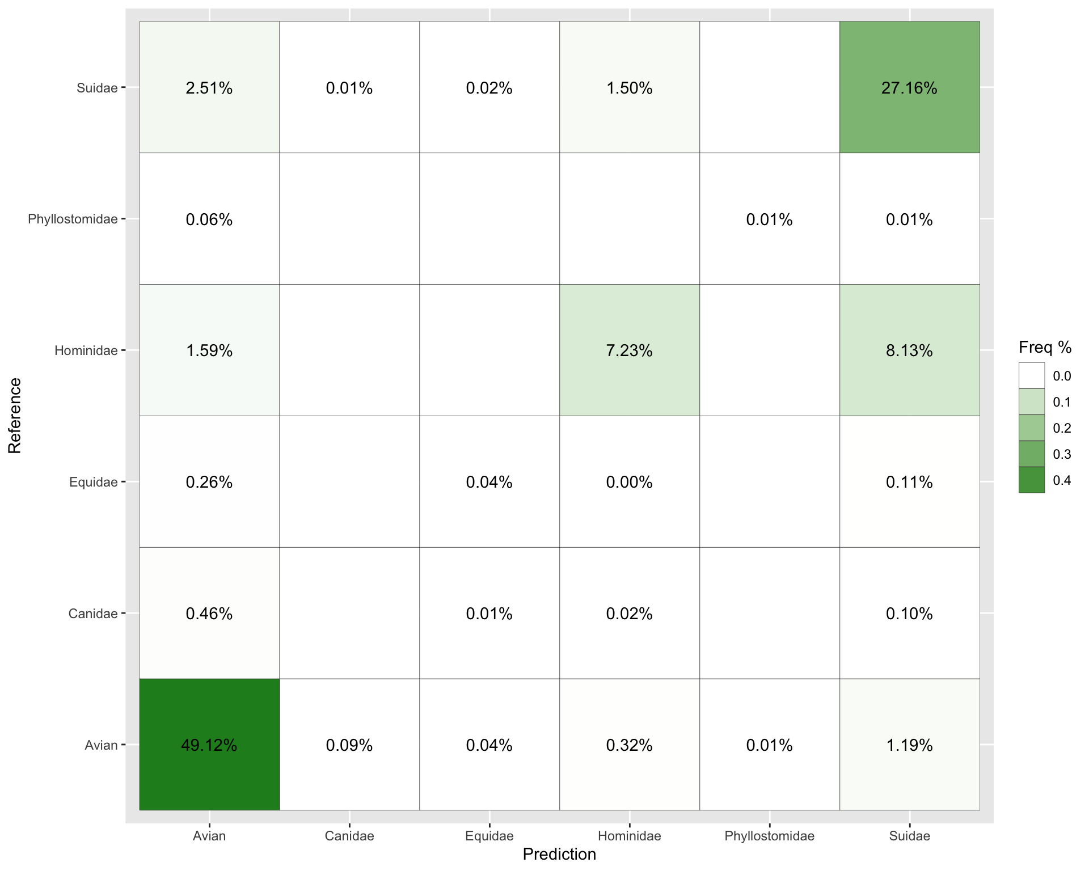
Frequency of Mis-labelled Predictions
Frequencies <0.01% not shown
2.51% of swine-origin samples were incorrectly predicted as avian-origin
Human-origin sequences were more likely to be classed as swine-origin (8.13%) than from humans (7.23%)
While misclassification is obviously undesirable when making host predictions, it was desirable for our question: we wanted some ancestral host signal manifesting so we can compare it to the phylogenetic structure

Slide 13
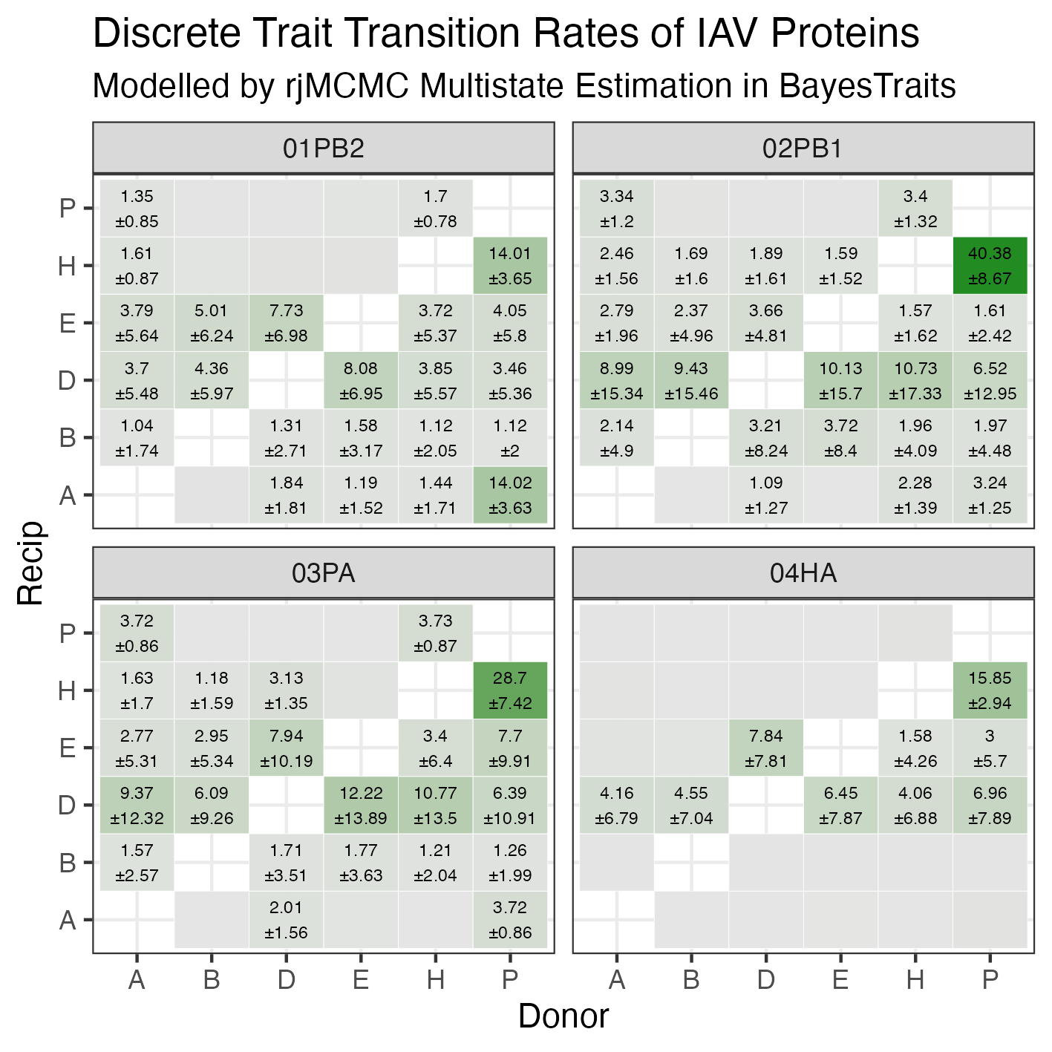
Phylogenetics
How neatly do protein physio-chemical properties map onto trees?
8 trees, one for each genomic segment
Do the patterns match predictions from the ML models?
Notes:
With the models (almost) done, I’m moving onto the phylogenetics side of the project

Slide 14
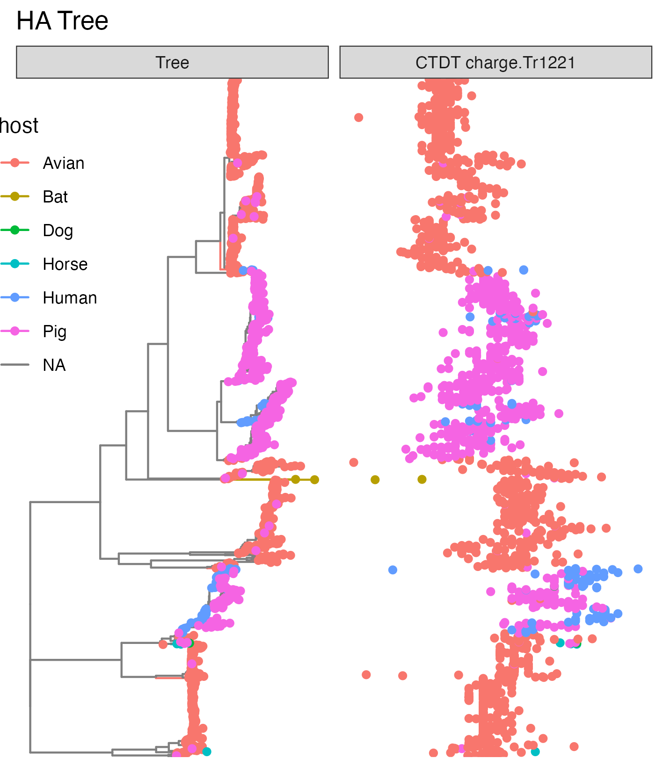
Phylogenetics
How neatly do protein physio-chemical properties map onto trees?
8 trees, one for each genomic segment
Do the patterns match predictions from the ML models?
0.12
0.14
0.16
0.18
0.20
Charge Tr1221
Notes:
With the models (almost) done, I’m moving onto the phylogenetics side of the project

Slide 15
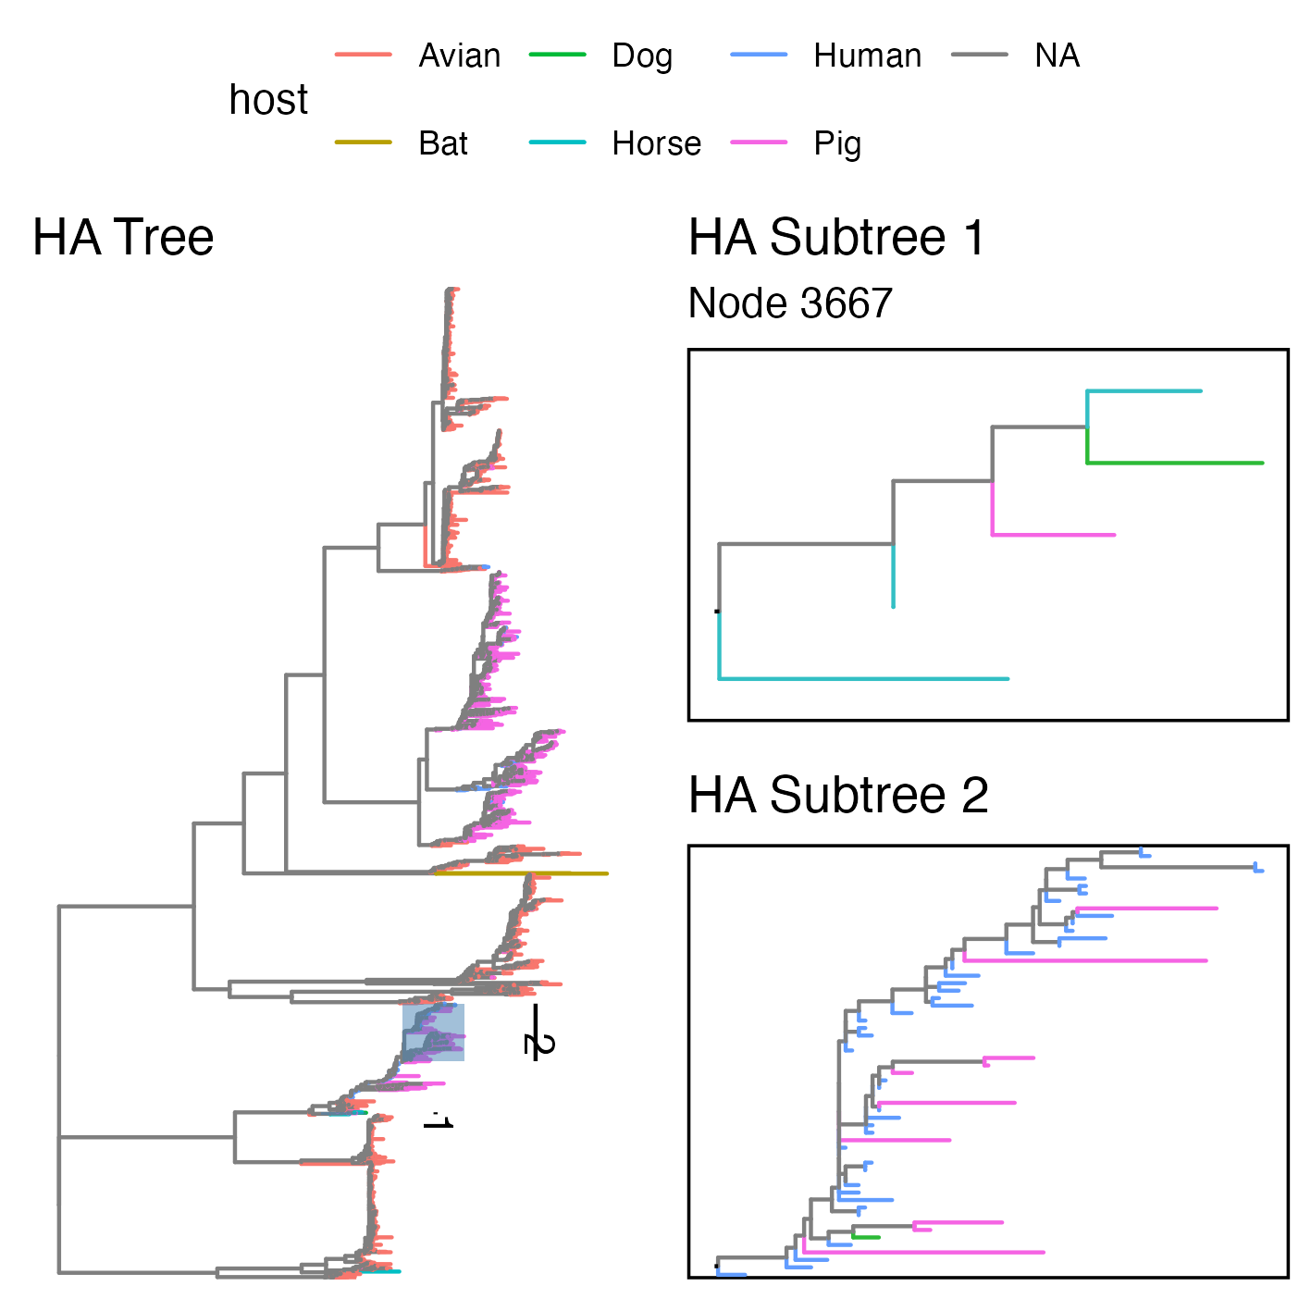
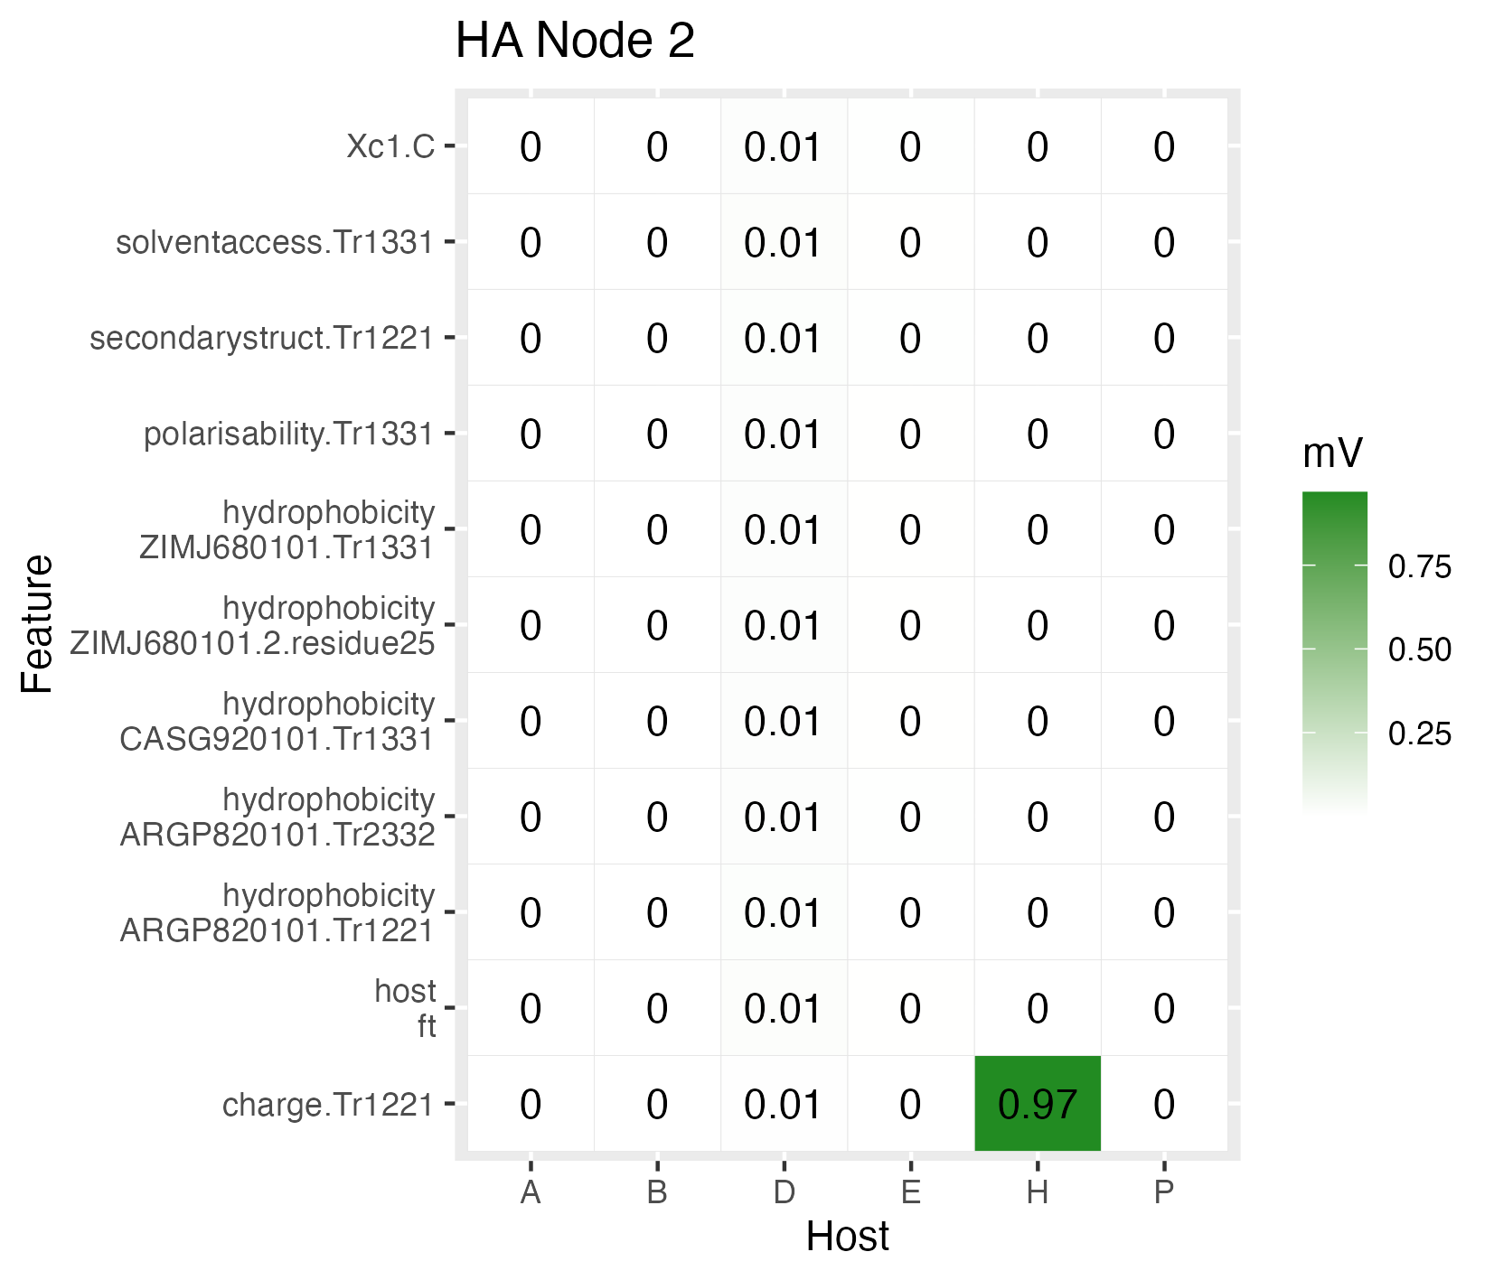
Validation: Models to Phylogenetics

Slide 16
Future Directions
Validation 2: Phylogenetics to ML models
Protein sub-regions
Haemagglutinin stalk vs head
Further host splits
waterfowl vs other birds

Slide 17

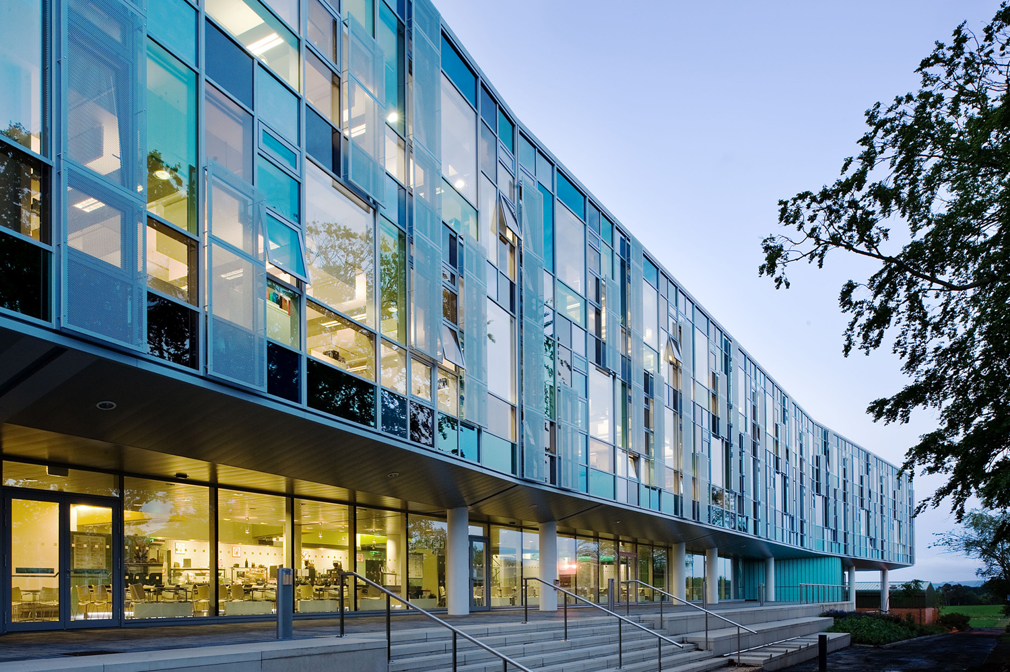


Visit to Roslin Institute, Edinburgh
Notes:
Finish by talking about what this funding allowed
Jordan was just finishing PhD when he approached me about postdoc opportunities and this allowed us to co-design this project and support Jordan as an early career research for 6 months
In that time Jordan was able to train in foundational machine learning and put it into practice
This also funded Jordan to visit the Roslin Inst, Edinburgh to work alongside influenza phylogenetics experts and present the work
Engaged with HZI project partners online

Slide 18



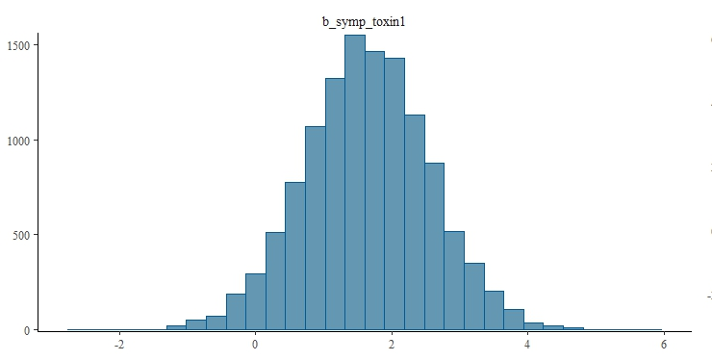
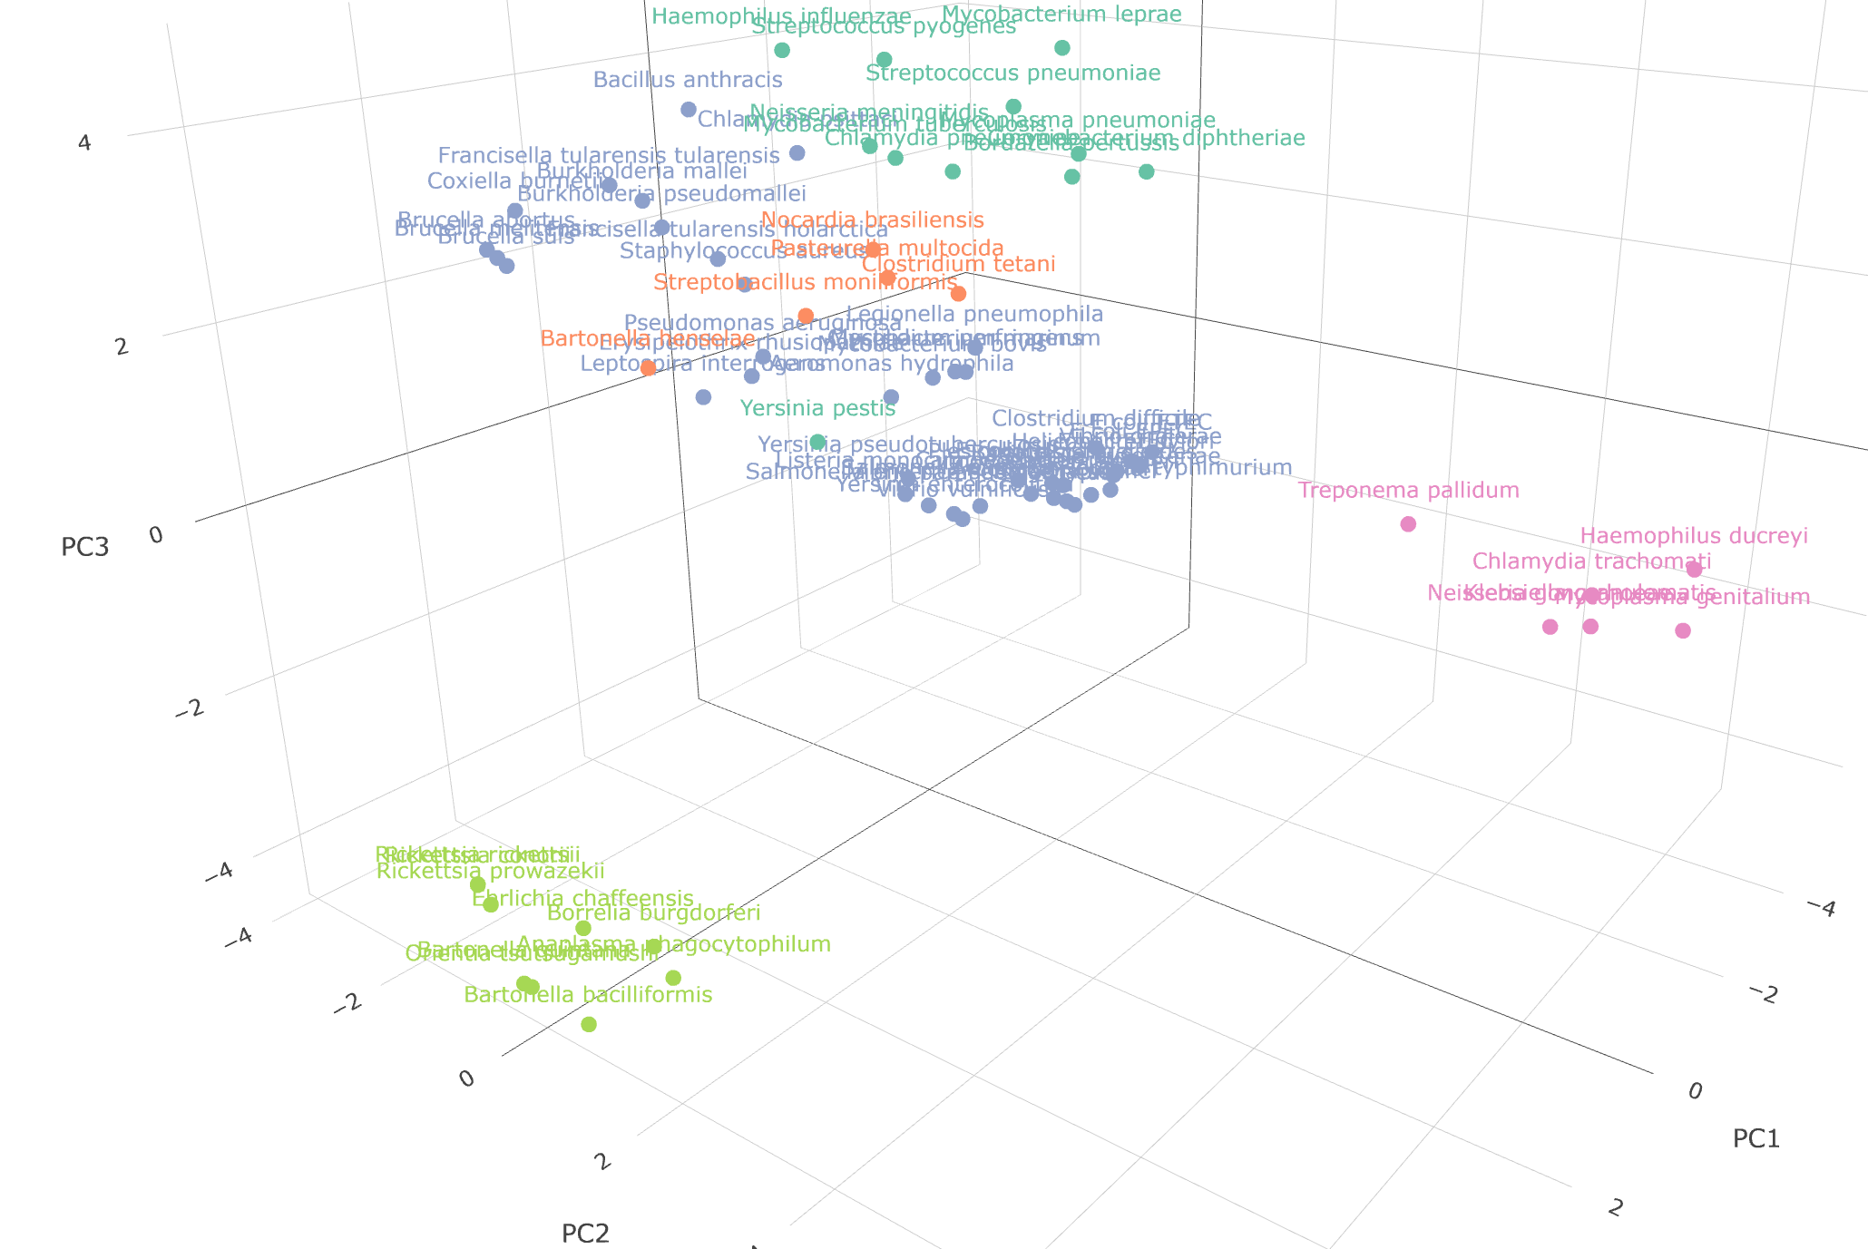
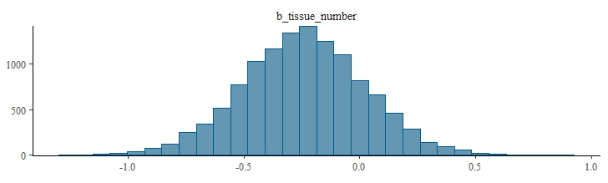
log-odds: toxin use
log-odds: tissue generalism
Notes:
The funds we were awarded also allowed a placement for Hattie Herridge 1st year PhD with Fabian in Ecology and Emergence of Zoonotic Disease group to come to the CVR and work with us for 2 weeks
I’d been talking with Hattie and her masters supervisor from Exeter for a while about a collaboration and this really helped it materialise
Because in that two weeks we were able to train Hattie in some statistical methods like factor analysis where she was able to distinguish pathogenic bacteria in terms of grouped ecology and epidemiology and found distinct clustering of vector-borne bacteria, sexually transmitted bacteria, and then everything else
And she also built some evolutionary models, using Bayesian phylogenetic regression to find out which traits explain virulence and found effects in the posterior like toxin use but less obvious ones like a protective effect of tissue generalism

Slide 19
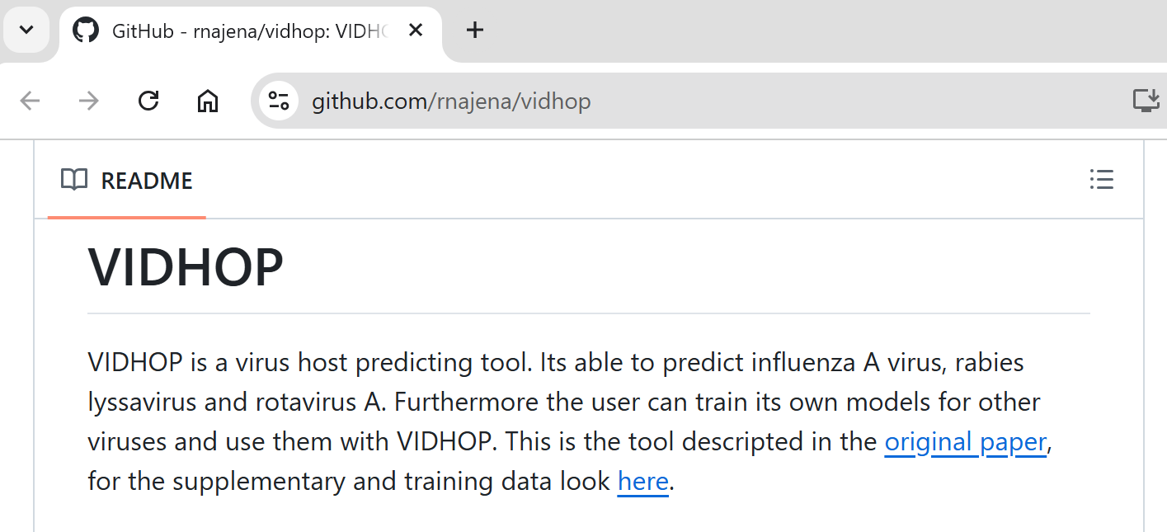
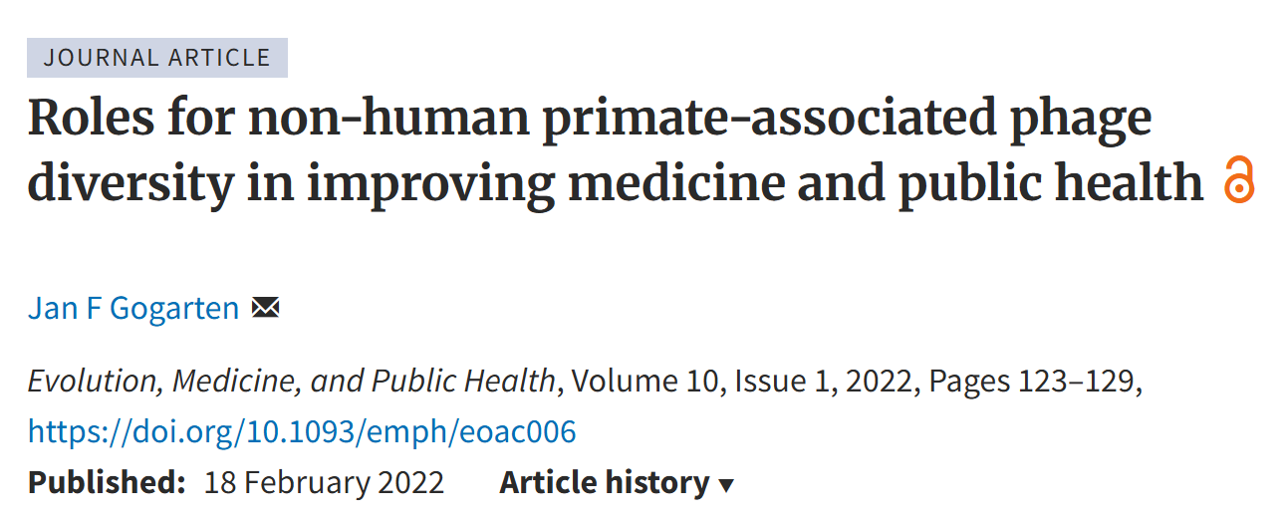
Host predictors are very common, and often put to secondary use
But better guidance needed on interpretation
Scope for Commentary piece, etc.
Apply to other well-sampled systems with host shifts
Primate phageome (Gogarten): 1000s of phage from many nhps!
Notes:
But in terms of where this funding leaves us,
Well host predictor models are really common in the literature now, there are many many more than those four examples at the start And while they are very accessible for secondary use, which is great - they tend to be used indiscriminately as an off-the-shelf push-button analytical tool So we are in a nice position to guide better interpretation and use our findings to suggest good practice in something like a Commentary piece
In terms of future work we can also adapt framework we built to investigate other well-sampled systems where we know host shifts are taking place One area of interest is the phageome data that is being led by Jan Gogarten that covers thousands of phage sampled from many different non-human primates and other datasets emerging from HIOH

Slide 20







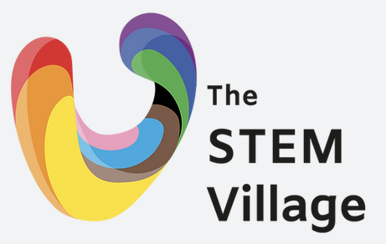

VIBE (Viral Informatics, Biostatistics, and Evolution) Research Lab
LinkedIn

Slide 21
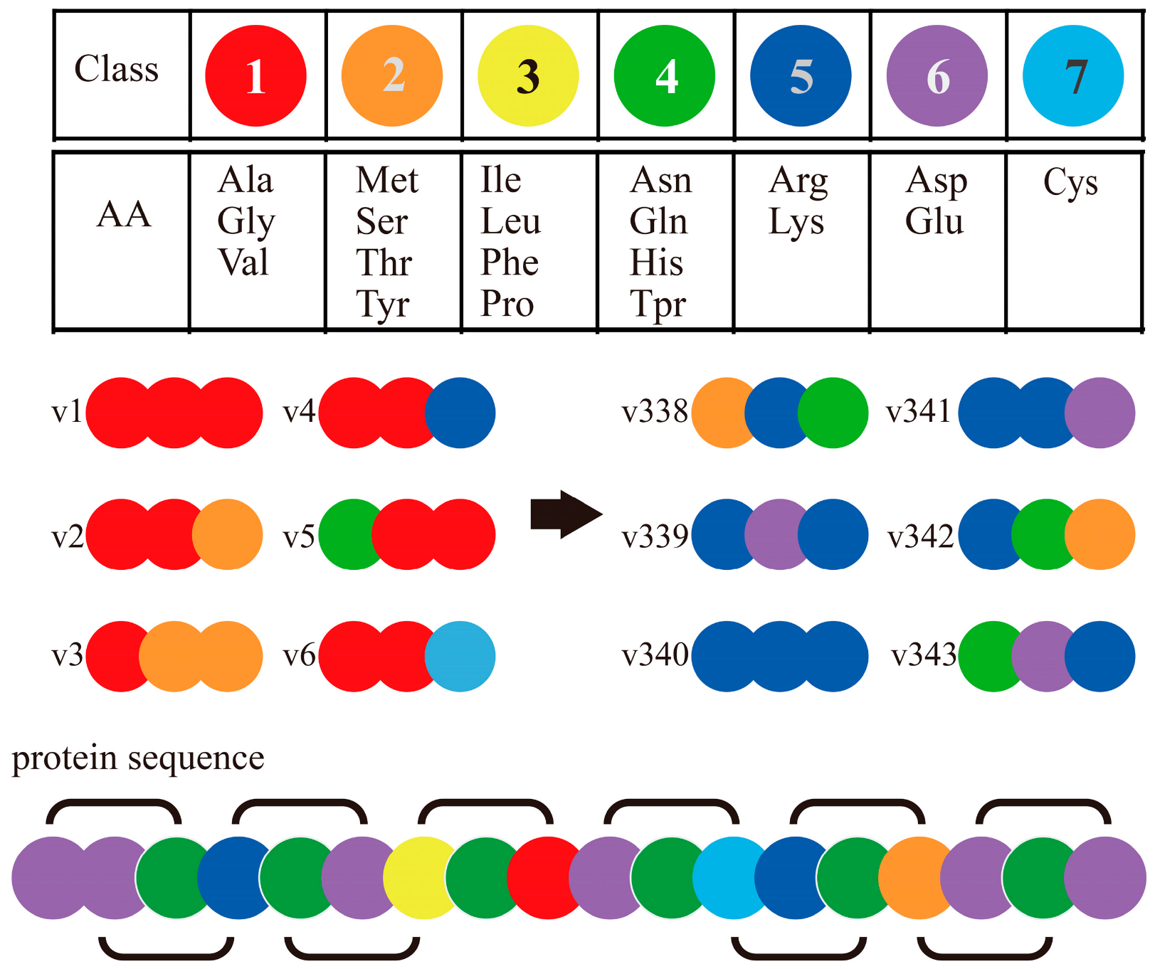
Conjoint Triad
Divide amino acids into seven groups based on their overall properties
Consider this a reduced alphabet (20 -> 7) and count composition of each “triad”
i.e. How often do you see in the sequence a 1-1-1, 1-1-2, etc.. up to 7-7-7
Gives a vector of 7^3 = 343 features
Shen et al. PNAS. 2007; 104: 4337-41.
Figure from iFeaturesOmega
Notes:
First is the conjoint triad method where we divide amino acids into 7 groups based on their overall properties, mostly volume and electrostatic interaction
We can then consider this like a reduced amino acid alphabet down from 20 characters to 7, and count the composition of each possible set of three or triad like how often do you see in the sequence … all the way up to 7-7-7
This gives us a 7^3 or 343 features

Slide 22
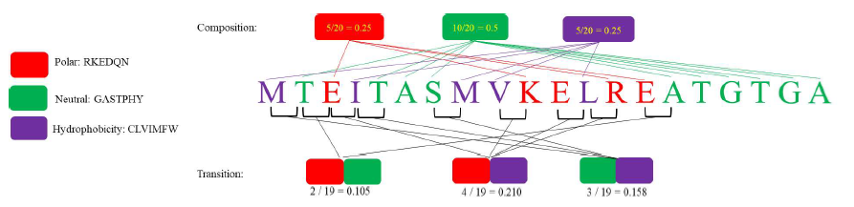
Composition-Transition-Distribution
Divide amino acids into three groups based on one property
Consider this a reduced alphabet (20 -> 3) and count:
Figure from iFeaturesOmega
Distribution:
What proportion of sequence must you cover before you hit given quartile of group content?
e.g. half of all polar residues present are in first 30% of the sequence, D_0.5_polar = 0.3
Repeat for first residue, all quartiles (15 features)
Composition:
Simple composition of each group (3 features)
Transition:
Simple composition of each group pair (3 features - reversible)
Notes:
This second method is similar but this time we look at one property at once, and divide amino acids into 3 groups so in this example it’s based on hydrophobicity where it’s either polar in red neutral in green or hydrophilic in purple
We then again consider it a reduced alphabet and count Composition which is dead easy, exactly as we’ve done before what’s the composition bias of each group Transition which is just another way of doing the same for residue pairs but we group together reversible pairs so polar-neutral is same as neutral-polar
Distribution: a little complicated, but consider what proportion of the sequence you have to cover before you hit a given quartile of the amino acids content in each group. e.g. if half of all polar residues in the entire sequence are bunched up into the first 30%, D0.5pol = 0.3. Calculate first residue, first quartile, second quartile, third quartile, last residue. So Distribution unique in that it captures positional information
And we have only what 21 feats from this but we can repeat for any number of properties we like to get more and more

Slide 23
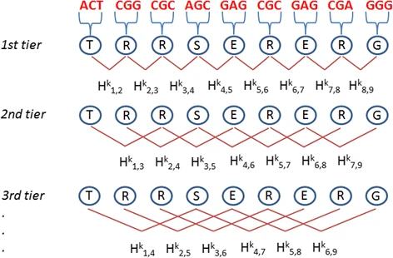
Pseudo-amino acid composition
Calculate composition (simple proportion) of each amino acid (20 features)
Calculate similarity between amino acids (correlation between properties) up to λ residues apart (λ features)
Chou. Proteins 2001; 43: 246-55.
Figure from iFeaturesOmega
Notes:
And last one to cover today is Pseudo amino acid composition which is maybe simplest
First we just really simply calculate proportion of each amino acid in the sequence to give us starting 20 features
Then we capture how similar amino acids are at given distances apart by calculating correlation between them which is just average squared distance between property values (for hydrophobicity hydrophilicity and mass), and we go up to distance lambda so if lamba is 3 we have third order correlation, 3 features capturing similarity of amino acids that are 1) adjacent, 2) apart by 1, and 3) apart by 2.
So pseudo-AAC also doesn’t just capture composition but positional information. And all of these should say are not exclusively used in virology but across all sorts of biochem and molecular biology

